Slide 1

Mobile Learning Application Development
Presented By:
Rakib Hossen
Assistant Professor
Dept. of Cyber Security Engineering (CySE), UFTB

Slide 2
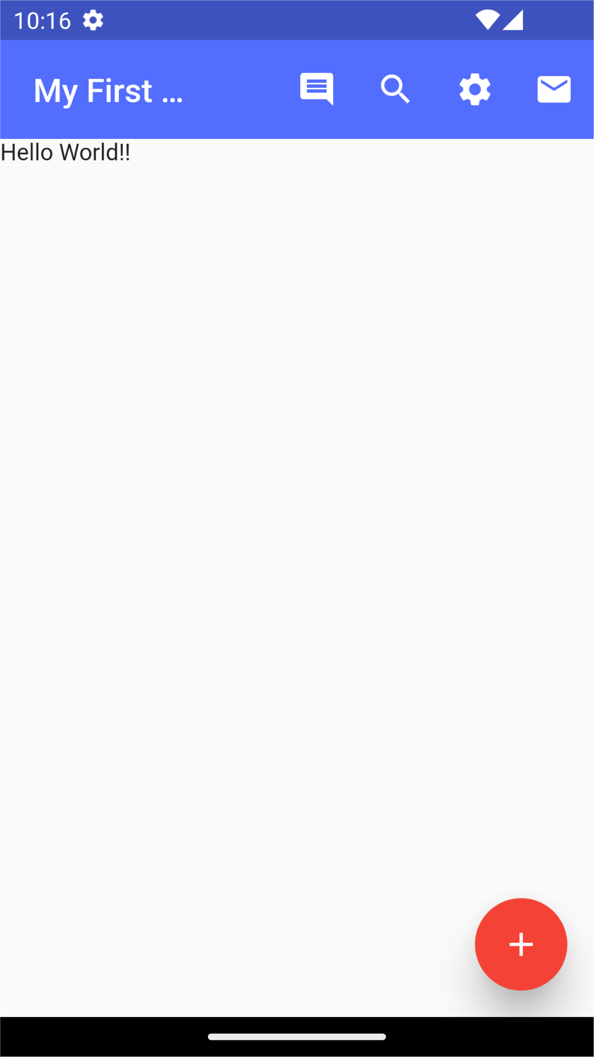
Floating Action Button
Floating Action Button is a button that is placed at the right bottom corner by default.
Floating Action Button is an icon button that floats over the content of the screen at a fixed place.
Official documentation: https://api.flutter.dev/flutter/material/FloatingActionButton- class.html

Slide 3
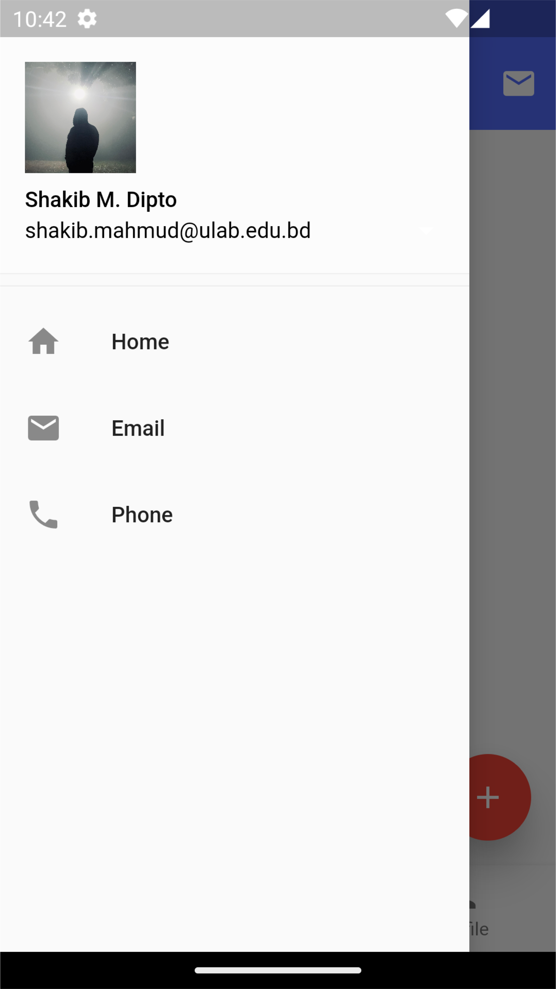
Bottom Navigation Bar
Material Design Navigation Drawer component.
Consist of header and list items
On top of Drawers, Navigation drawers offer a persistent and convenient way to switch between primary destinations in an app.
The style for the icons and text are not affected by parent DefaultTextStyles or IconThemes but rather controlled by parameters or the NavigationDrawerThemeData.
Official documentation: https://api.flutter.dev/flutter/material/NavigationDrawer-class.html

Slide 4
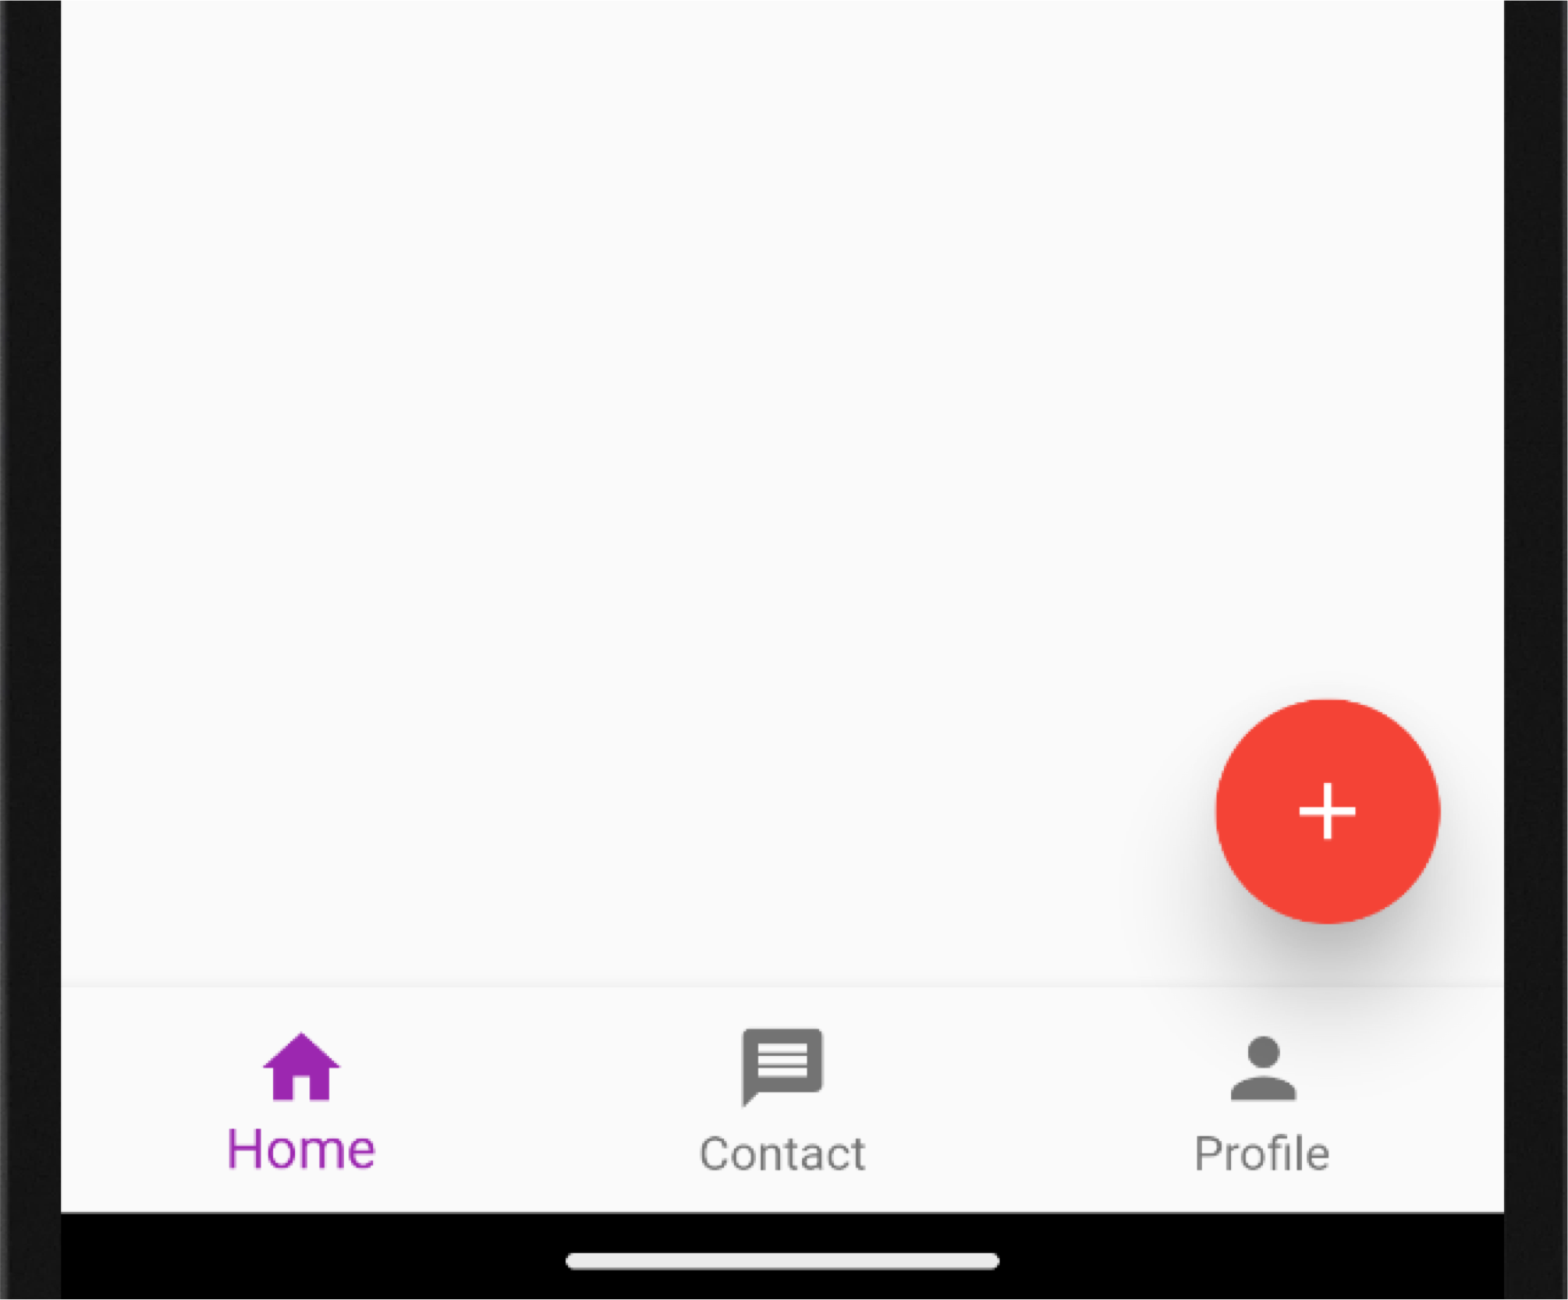
Bottom Navigation Bar
Menu at the bottom of the Scaffold.
We have seen this Navigation bar in most of the applications.
We can add multiple icons or texts or both in the bar as items.
Official documentation:
https://api.flutter.dev/flutter/material/BottomNavigationBar- class.html

